Slide 1
CHAIN OF RESPONSIBILITY
Behavioral Pattern

Slide 2
INTENT
Avoid coupling the sender of a request to its
receiver by giving more than one object
chance to handle the request. Chain the
receiving objects and pass the request along
the chain until an object handles it.

Slide 3
MOTIVATION
Consider a context-sensitive help facility for a
graphical user interface.
If there is help for the button => show it, otherwise
If there is help for the dialog => show it, otherwise
If there is help for the application => show it, otherwise ...
The problem: the object that ultimately provides
the help isn't known explicitly to the object (e.g.,
the button) that initiates the help request.

Slide 4
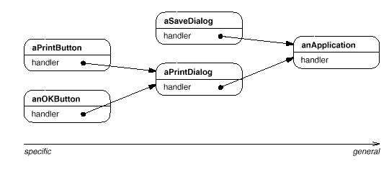
MOTIVATION

Slide 5
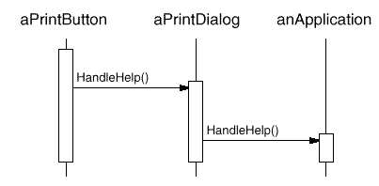
MOTIVATION

Slide 6
APPLICABILITY
More than one object may handle a request, and the handler isn‘t known a priori. The handler should be ascertained automatically.
You want to issue a request to one of several objects without specifying the receiver explicitly.
The set of objects that can handle a request should be specified dynamically.

Slide 7
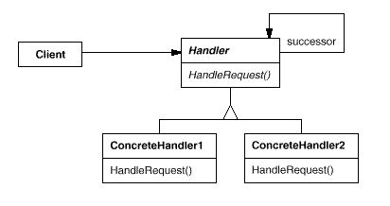
STRUCTURE

Slide 8
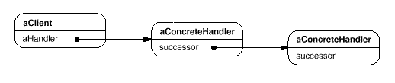
OBJECT STRUCTURE

Slide 9
PARTICIPANTS
Handler (HelpHandler) - defines an interface for handling requests.
ConcreteHandler (PrintButton, PrintDialog) - handles requests it is responsible for. It can access its successor. If the ConcreteHandler can handle the request, it does so; otherwise it forwards the request to its successor.
Client - initiates the request to a ConcreteHandler object on the chain.

Slide 10
BENEFITS
Reduced coupling: The pattern frees an object from knowing which other object handles a request. An object only has to know that a request will be handled "appropriately." Both the receiver and the sender have no explicit knowledge of each other, and an object in the chain doesn't have to know about the chain's structure.

Slide 11
BENEFITS
Added flexibility in assigning responsibilities to objects. Chain of Responsibility gives you added flexibility in distributing responsibilities among objects.

Slide 12
DRAWBACKS
Receipt isn't guaranteed: Since a request has no explicit receiver, there‘s no guarantee it'll be handled—the request can fall off the end of the chain without ever being handled.

Slide 13
RELATED PATTERNS
Chain of Responsibility is often applied in conjunction with Composite, where a component's parent can act as its successor.

Slide 14
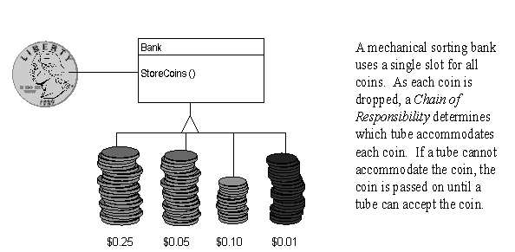
NON-SOFTWARE EXAMPLE

Slide 15
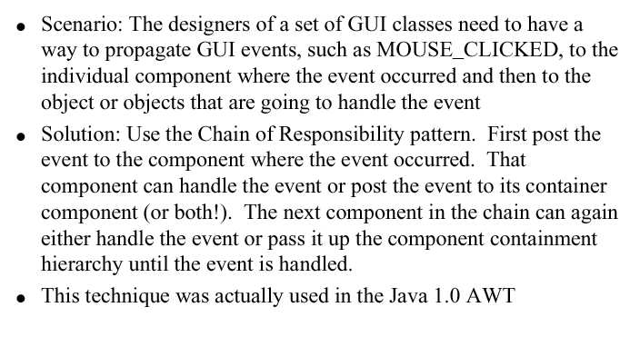
EXAMPLE 1

Slide 16
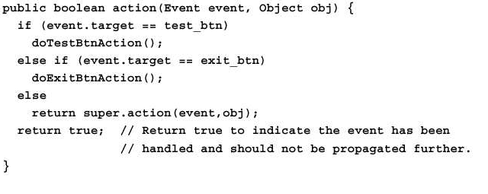
EXAMPLE 1

Slide 17
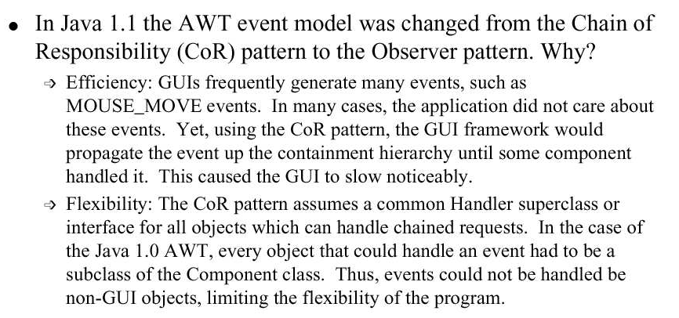
EXAMPLE 1

Slide 18
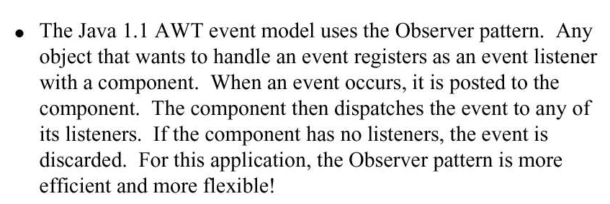
EXAMPLE 1

Slide 19
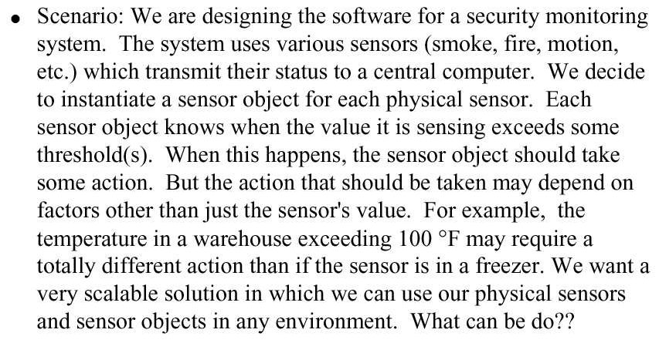
EXAMPLE 2

Slide 20
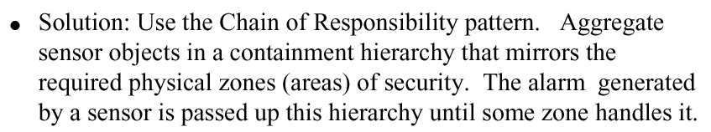
EXAMPLE 2

Slide 21
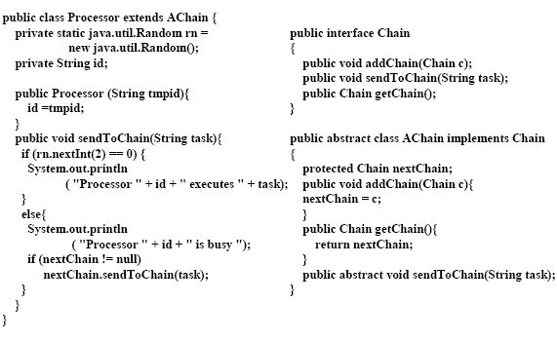
EXAMPLE 3

Slide 22
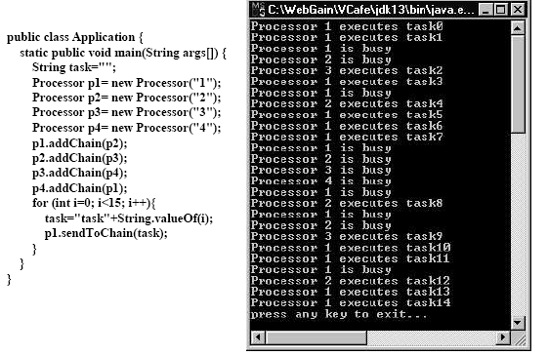
EXAMPLE 3

